Slide 1
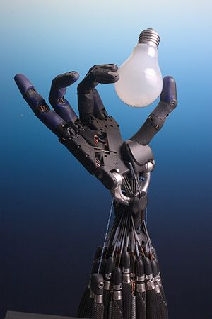
Tactile sense
By:
Reeham Mohamed
Sarah alaa eldin
Dr. yasser farouk

Slide 2
We will talk about:
What is tactile sensor.
Human tactile sense.
Tactile sense in industry.
Tactile sense in robots.
Tactile sense in human vs. robots.
Types of tactile sensors in robots.
Resistive based sensors.
Piezoelectric sensor.
Strain gauge in tactile sensors.
7. What is capacitive touch sensing.
8. Robots using tactile sense.

Slide 3
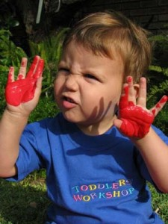
How many of us say: “Let me see!” and then stretch out our hands to touch an object? We are all dependent on our tactile sense to interpret and engage with the world around us

Slide 4
What is tactile sensor.
Human tactile sense.
Tactile sense in industry.
Tactile sense in robots.
Tactile sense in human vs. robots.
Types of tactile sensors in robots.
Resistive based sensors.
Piezoelectric sensor.
Strain gauge in tactile sensors.
7. What is capacitive touch sensing.
8. Robots using tactile sense.

Slide 5
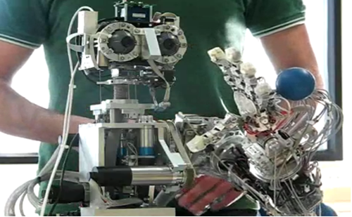
Tactile sensor usually refers to a transducer that is sensitive to touch, force, or pressure.
Tactile sensors are employed where ever interactions between a contact surface and the environment are to be measured .it is useful in a wide variety of applications for robotics and computer hardware.

Slide 6
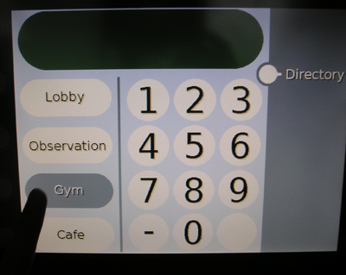
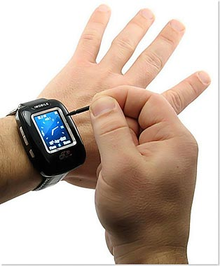
Tactile Sensors are used all the time in everyday objects such as elevator buttons and lamps which dim or brighten by touching the base

Slide 7
What is tactile sensor.
Human tactile sense.
Tactile sense in industry.
Tactile sense in robots.
Tactile sense in human vs. robots.
Types of tactile sensors in robots.
Resistive based sensors.
Piezoelectric sensor.
Strain gauge in tactile sensors.
7. What is touch capacitive touch sensing.
8. Robots using tactile sense.

Slide 8

The tactile system is the first sensory system to develop in the womb and develops from the same step with nervous system. It is able to function effectively when the visual and auditory systems are just beginning to develop.
The skin thus plays an important role
in regulating our nervous system.

Slide 9
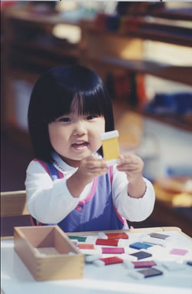
Why People Can Pick Up Objects with Their Fingers?
There are two ways we grip things. One way is by applying strong pressure,
While, the other way is by tenderly fondling an object

Slide 10
What is tactile sensor.
Human tactile sense.
Tactile sense in industry.
Tactile sense in robots.
Tactile sense in human vs. robots.
Types of tactile sensors in robots.
Resistive based sensors.
Piezoelectric sensor.
Strain gauge in tactile sensors.
7. What is touch capacitive touch sensing.
8. Robots using tactile sense.

Slide 11
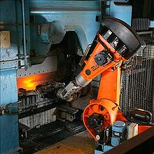
Tactile sensors have been noted to be used in the manufacturing of automobiles Tactile Sensors can indicate the presence or shape of an object, its location in the hand, and the force of contact.
a pick and place robot in a factory

Slide 12
What is tactile sensor.
Human tactile sense.
Tactile sense in industry.
Tactile sense in robots.
Tactile sense in human vs. robots.
Types of tactile sensors in robots.
Resistive based sensors.
Piezoelectric sensor.
Strain gauge in tactile sensors.
7. What is capacitive touch sensing.
8. Robots using tactile sense.

Slide 13
A transducer, usually associated with a robot end effectors, that is sensitive to touch and applied stress.

Slide 14
What is tactile sensor.
Human tactile sense.
Tactile sense in industry.
Tactile sense in robots.
Tactile sense in human vs. robots.
Types of tactile sensors in robots.
Resistive based sensors.
Piezoelectric sensor.
Strain gauge in tactile sensors.
7. What is capacitive touch sensing.
8. Robots using tactile sense.

Slide 15
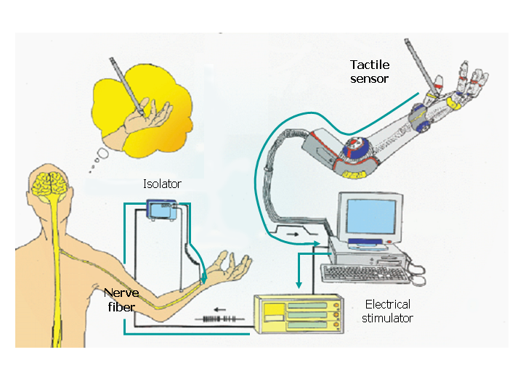
As the figure shown below the mechanism of sensing needs controller .it is the brain in human and computer or any controller (microcontroller, computer and plc) in robots

Slide 16
What is tactile sensor.
Human tactile sense.
Tactile sense in industry.
Tactile sense in robots.
Tactile sense in human vs. robots.
Types of tactile sensors in robots.
Resistive based sensors.
Piezoelectric sensor.
Strain gauge in tactile sensors.
7. What is capacitive touch sensing.
8. Robots using tactile sense.

Slide 17
Tactile Sensors are generally and can be grouped into a number of different types depending upon their construction; the most common groups are piezoelectric, Resistive based sensors , capacitive and strain gauge sensors

Slide 18
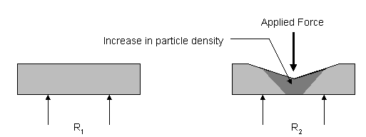
Resistive based sensors
The basic principle of this type of sensor is measuring changing on resistance of a conductive elastomer or foam between two points. The majority of the sensors use an elastomer that consists of a carbon doped rubber.

Slide 19
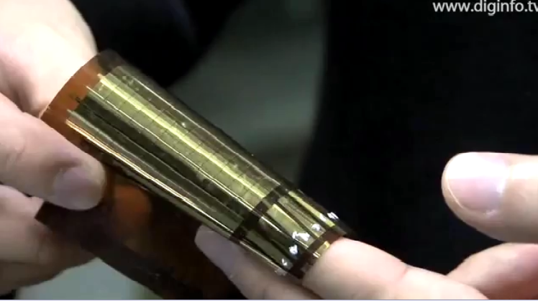
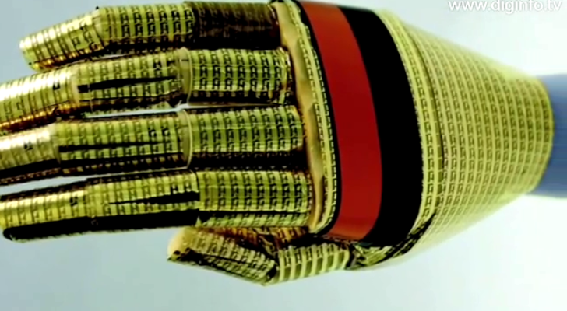
Piezoelectric sensors
Polyvinylidene fluoride is not piezoelectric in its raw state, but can be made piezoelectric by heating the PVDF within an electric field. PVDF is supplied sheets between as 5 microns and 2 mm thick, and has good mechanical properties. A thin layer of metallization is applied to both sides of the sheet to collect the charge and permit electrical connections being made.so we use it in artificial skin

Slide 20
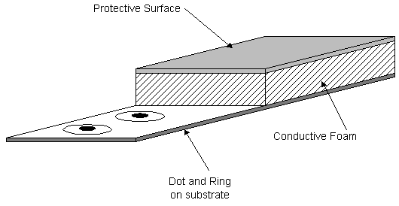
Strain gauges in tactile sensors
If the strain gauge is pre-stressed prior to the application of the backing medium, it is possible to measure both tensile and compressive stresses. When applied to robotic touch applications, the strain gauge is normally used in many configurations as a load cell, where the stress is measured directly at the point of contact

Slide 21
What is tactile sensor.
Human tactile sense.
Tactile sense in industry.
Tactile sense in robots.
Tactile sense in human vs. robots.
Types of tactile sensors in robots.
Resistive based sensors.
Piezoelectric sensor.
Strain gauge in tactile sensors.
7. What is capacitive touch sensing.
8. Robots using tactile sense.

Slide 22
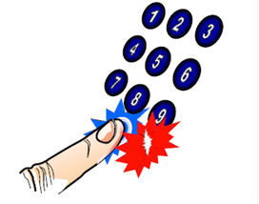
-Alternative to traditional push-button user interfaces.
- No mechanical movement.
-Completely sealed.
-Modern-looking design.
What is Touch Capacitive Touch Sensing??
Main components:
Touch Sensor
Relaxation Oscillator Circuit
Frequency Measurement

Slide 23
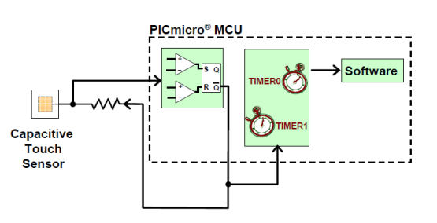
Overview of Capacitive Touch Sensing
First, we have the touch sensor itself. As the Capacitive Touch Sensing name implies, this sensor will produce a varying capacitance that will interact with a relaxation oscillator circuit. When the capacitance from the sensor changes

Slide 24
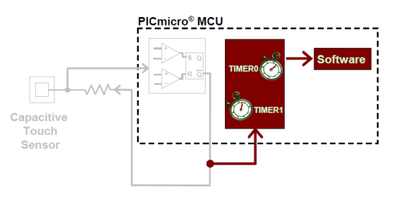
Frequency Measurement
In order to interpret this change in oscillator frequency, a frequency measurement component is required in our system. This component will interface hardware and software to accurately determine if and when a sensor has been touched.

Slide 25
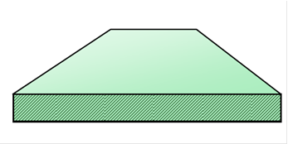
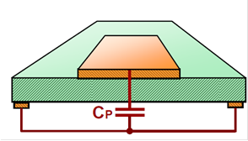
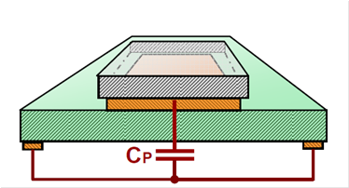
Touch Sensor Construction
Fiberglass
Copper (Cu) pads
Glass or Plexiglas

Slide 26
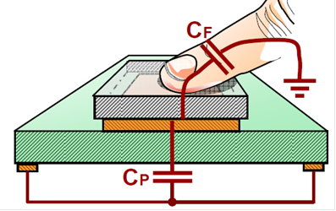
How does it work?
A finger touch will add a second capacitance in parallel with the pad’s capacitance.

Slide 27
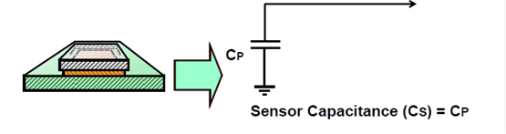
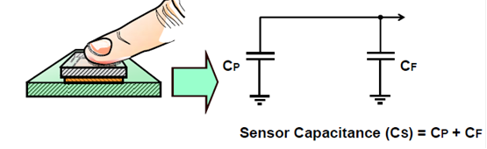
Equivalent Circuits

Slide 28
videos

Slide 29
Although, the researches proves that robot dealing with its environment reaches high levels it will never reaches the human level.
THANKS

